Slide 1
Bridging the Gap Between Anchor-based and Anchor-free Detection
via Adaptive Training Sample Selection
Shifeng Zhang Cheng Chi Yongqiang Yao
CVPR 2020
UCAS BUPT

Slide 2
Motivation
Difference Analysis of Anchor-based and Anchor-free Detection
The essential difference between anchor-based and anchor-free detection is actually how to defifine positive and negative training samples, which leads to the performance gap between them. If they adopt the same definition of positive and negative samples during training, there is no obvious difference in the final performance.
Anchor-based :Retinanet，Faster-RCNN
Anchor-free:FCOS，YOLOv1

Slide 3
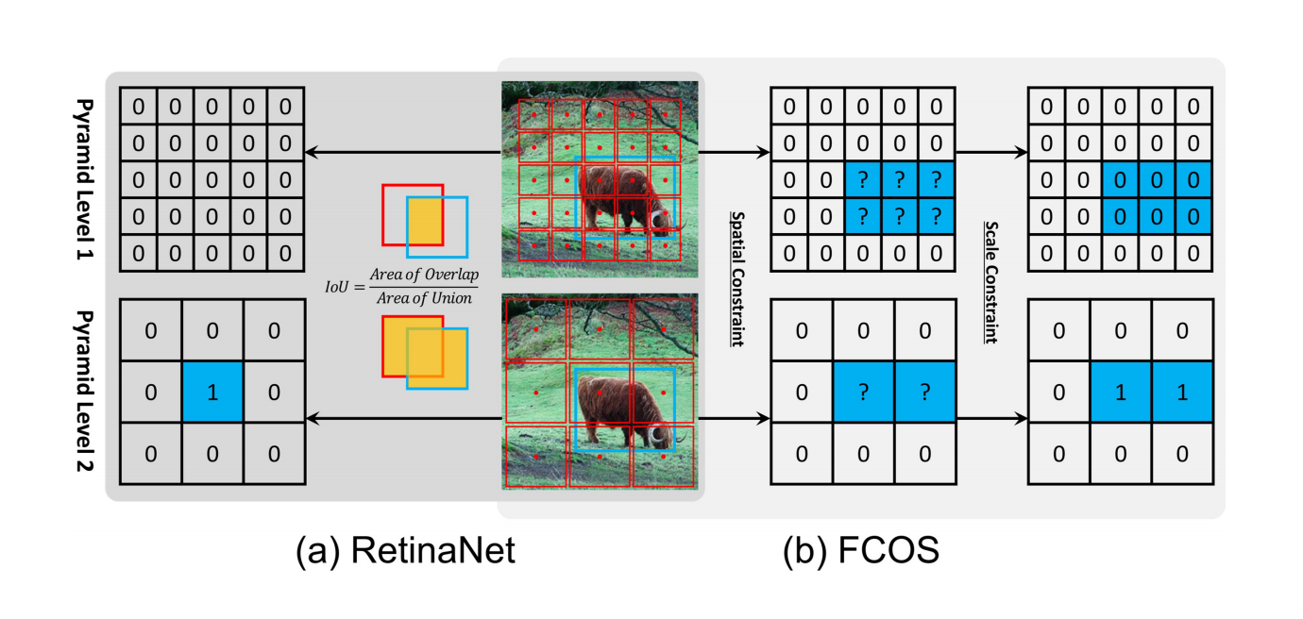
How to defifine positive and negative training samples
Defifinition of positives and negatives.Blue box, red box and red point are ground-truth, anchor box and anchor point. (a) RetinaNet uses IoU to select positives in spatial and scale dimension simultaneously. (b) FCOS first finds candidate positives in spatial dimension, then selects final positives in scale dimension.

Slide 4
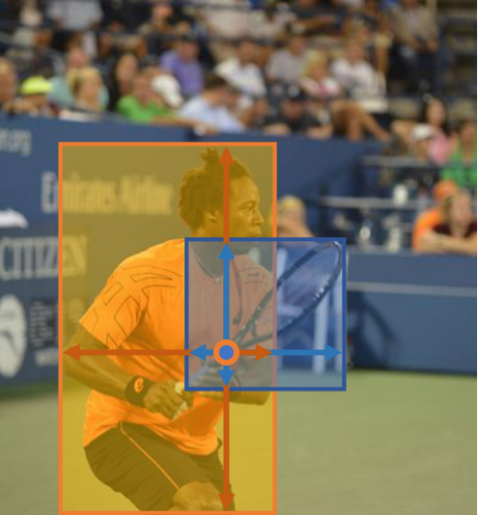
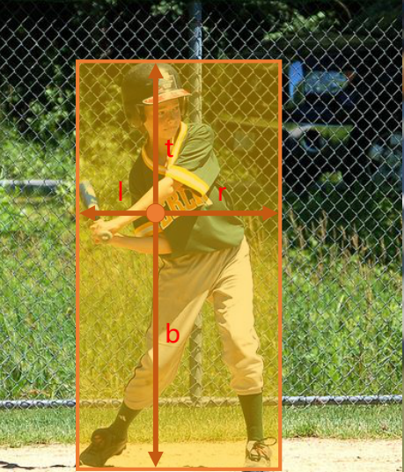
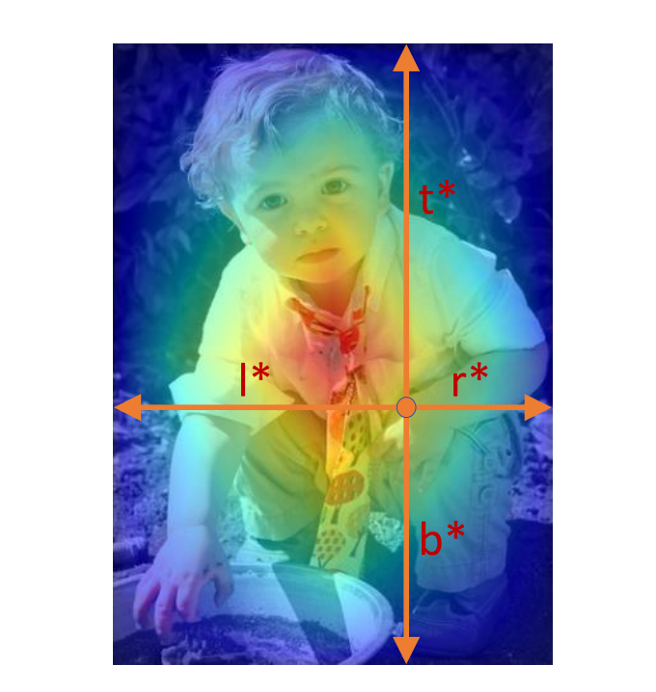
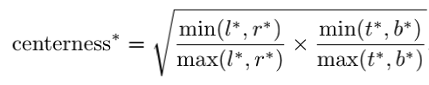
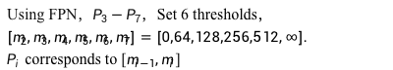
The pixels in the box are all regarded as positive samples, not limited to the center point
Label:
Using FPN，$P_{3}−P_{7}$，Set 6 thresholds，$\left[m_{2},m_{3},m_{4},m_{5},m_{6},m_{7}\right]=\left[0,64,128,256,512,∞\right].$
$P_{i}$ corresponds to [$m_{i−1},m_{i}$]

Slide 5
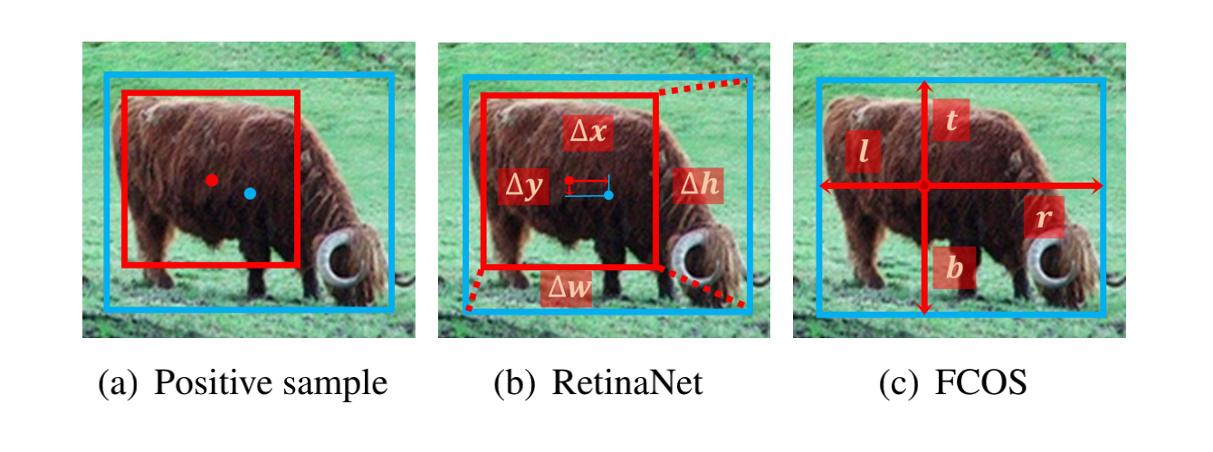
Summary of detection algorithm task
1. Design anchor
2.Selection of positive and negative samples of anchor
3. Offset and category of loss regression box
Blue point and box are the center and bound of object, red point and box are the center and bound of anchor. RetinaNet regresses from anchor box with four offsets. FCOS regresses from anchor point with four distances.

Slide 6
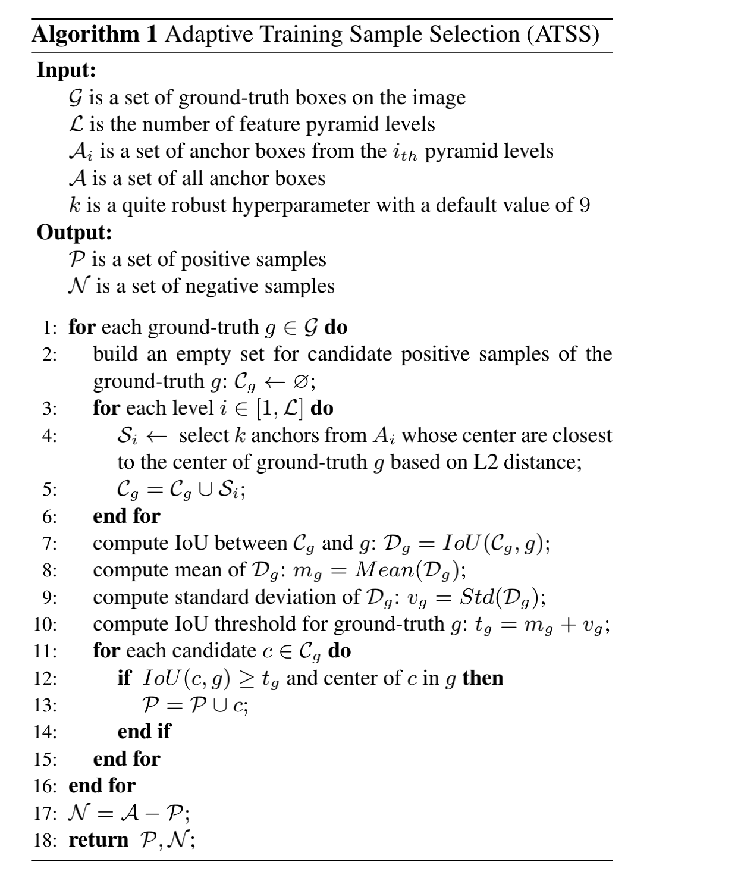
Method

Slide 7
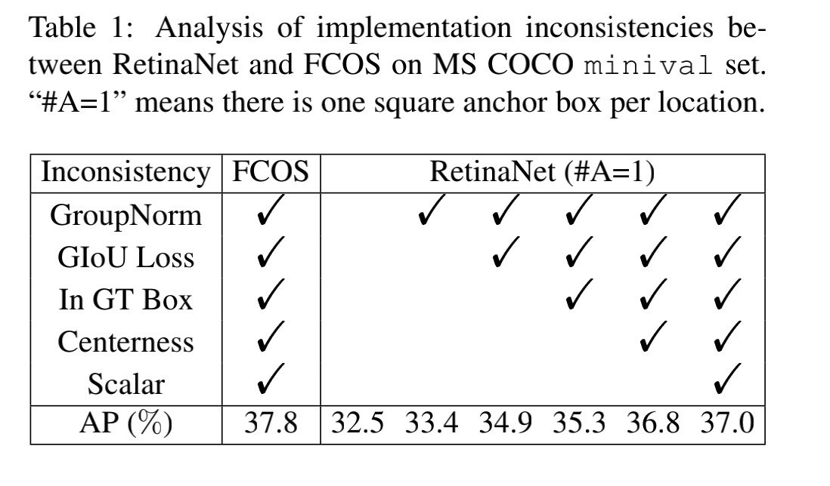
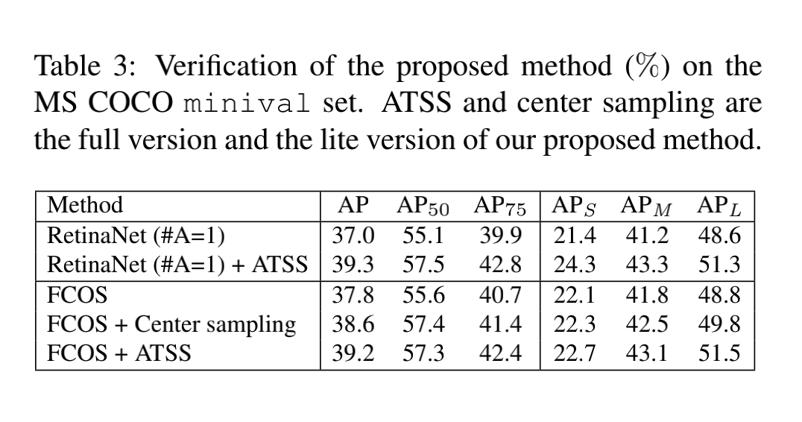
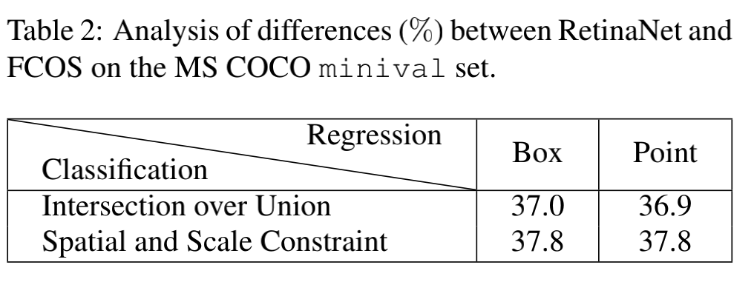
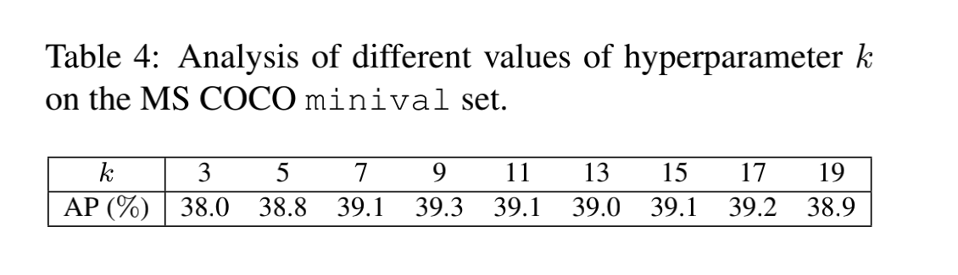
Experiments

Slide 8
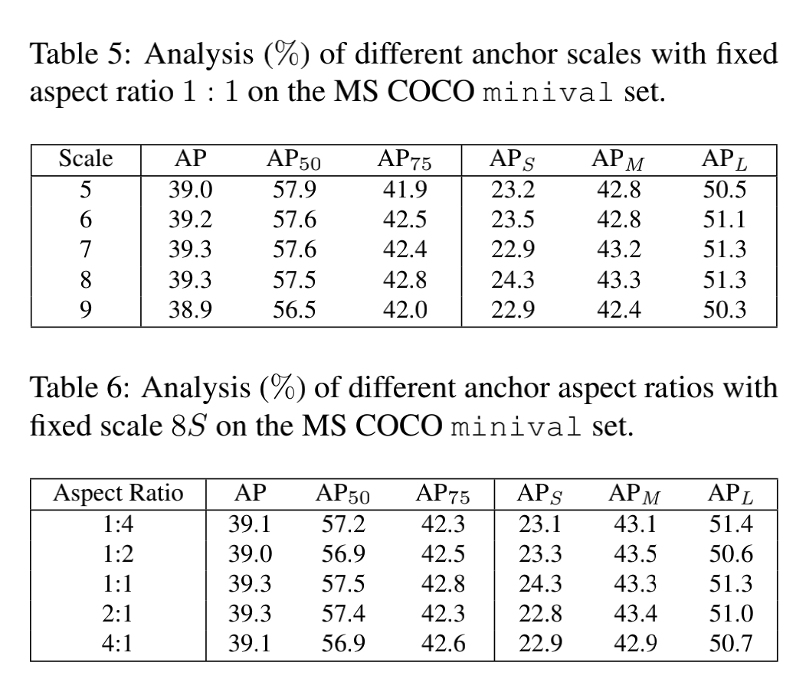
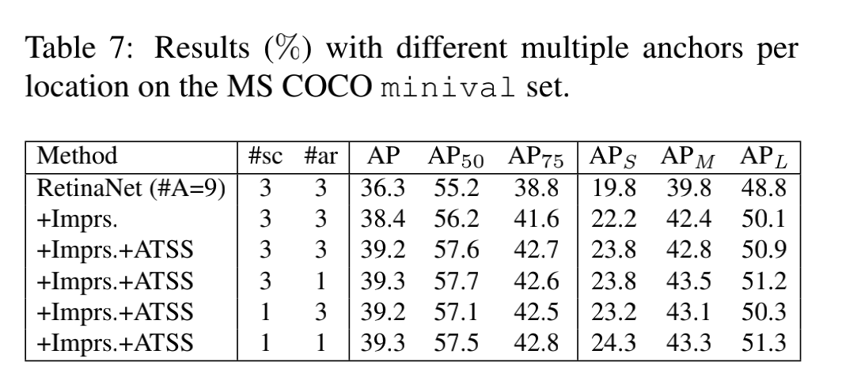
Experiments

Slide 9
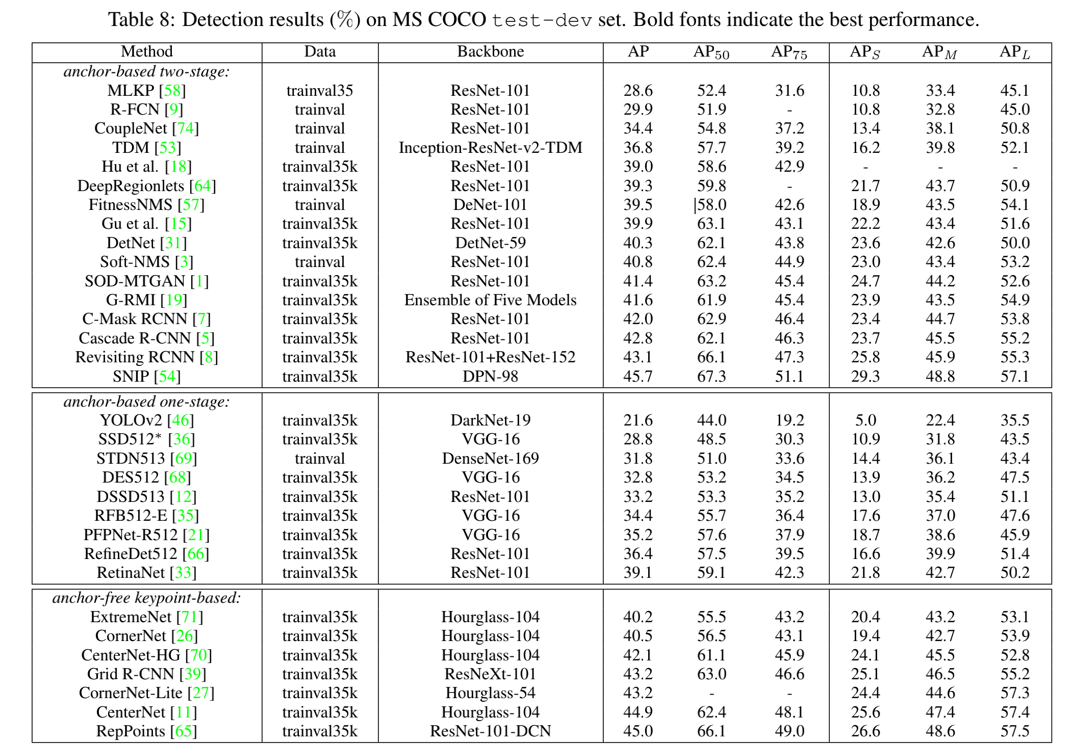
Experiments

Slide 10
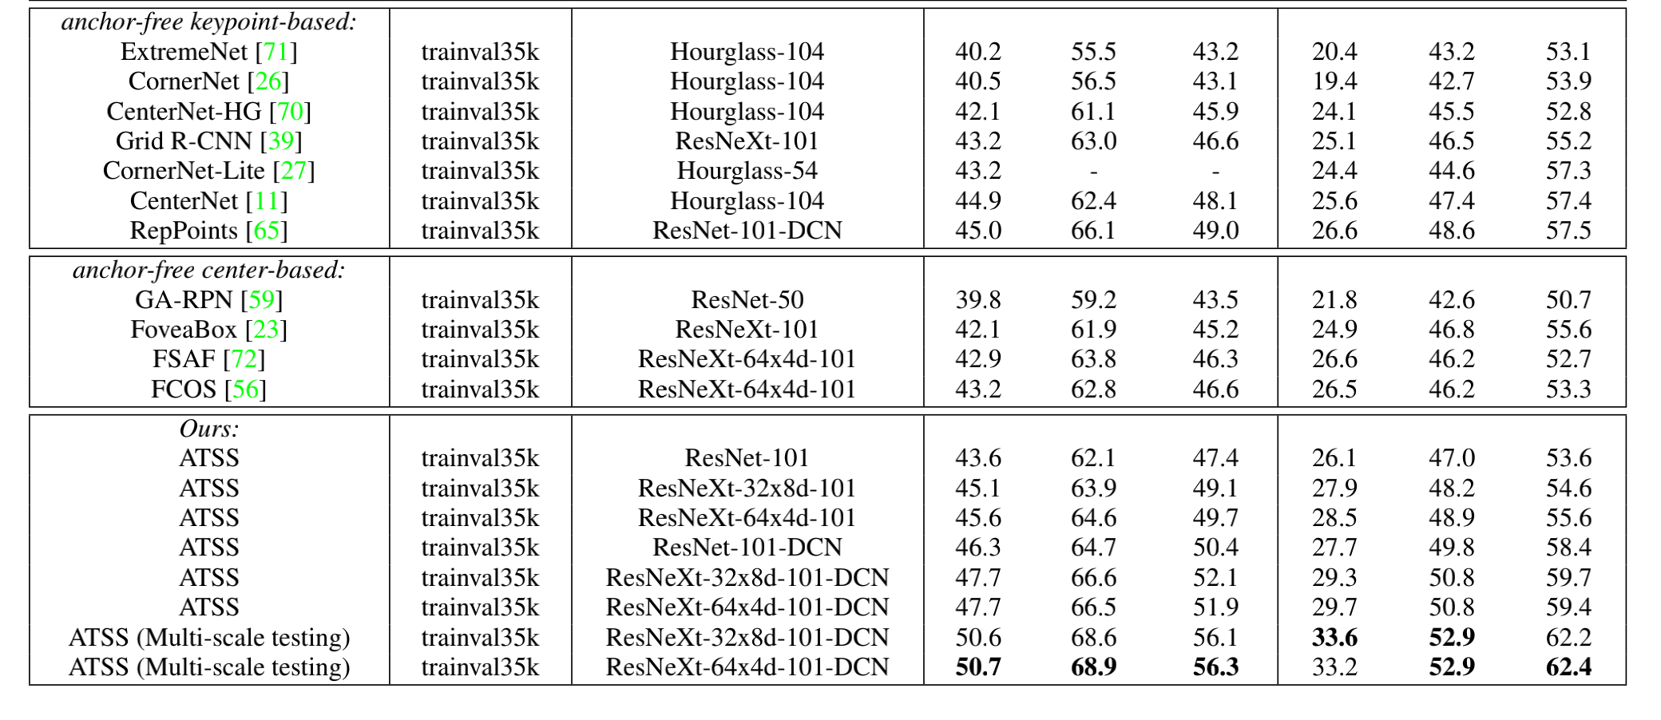
Experiments

